Slide 1
Pandemic Preparedness and Economic Performance
Dr. Tobias Dieler and Gautam Vyas

Slide 2
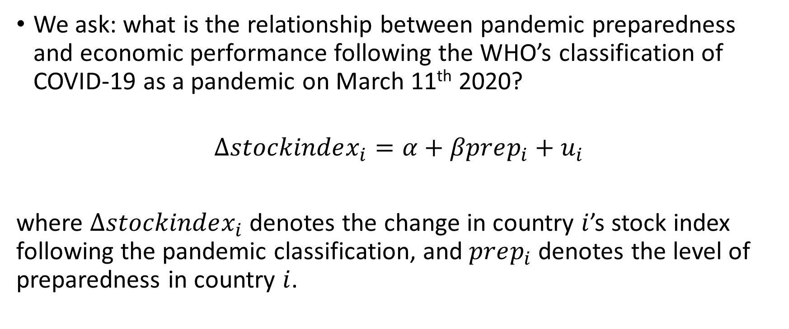
Introduction
We ask: what is the relationship between pandemic preparedness and economic performance following the WHO’s classification of COVID-19 as a pandemic on March 11th 2020?
$$∆stockindex_{i}=α+βprep_{i}+u_{i}$$
where $∆stockindex_{i}$ denotes the change in country $i$’s stock index following the pandemic classification, and $prep_{i}$ denotes the level of preparedness in country $i$.

Slide 3
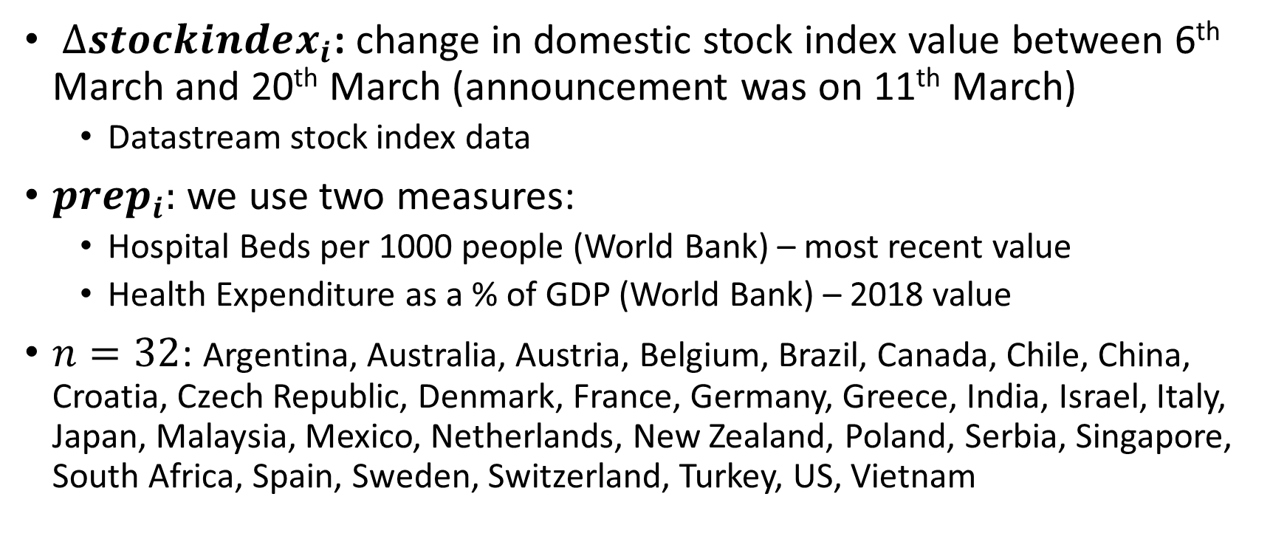
Data
$∆stockindex_{i}$: change in domestic stock index value between 6th March and 20th March (announcement was on 11th March)
Datastream stock index data
$prep_{i}:$ we use two measures:
Hospital Beds per 1000 people (World Bank) – most recent value
Health Expenditure as a % of GDP (World Bank) – 2018 value
$n=32$: Argentina, Australia, Austria, Belgium, Brazil, Canada, Chile, China, Croatia, Czech Republic, Denmark, France, Germany, Greece, India, Israel, Italy, Japan, Malaysia, Mexico, Netherlands, New Zealand, Poland, Serbia, Singapore, South Africa, Spain, Sweden, Switzerland, Turkey, US, Vietnam

Slide 4
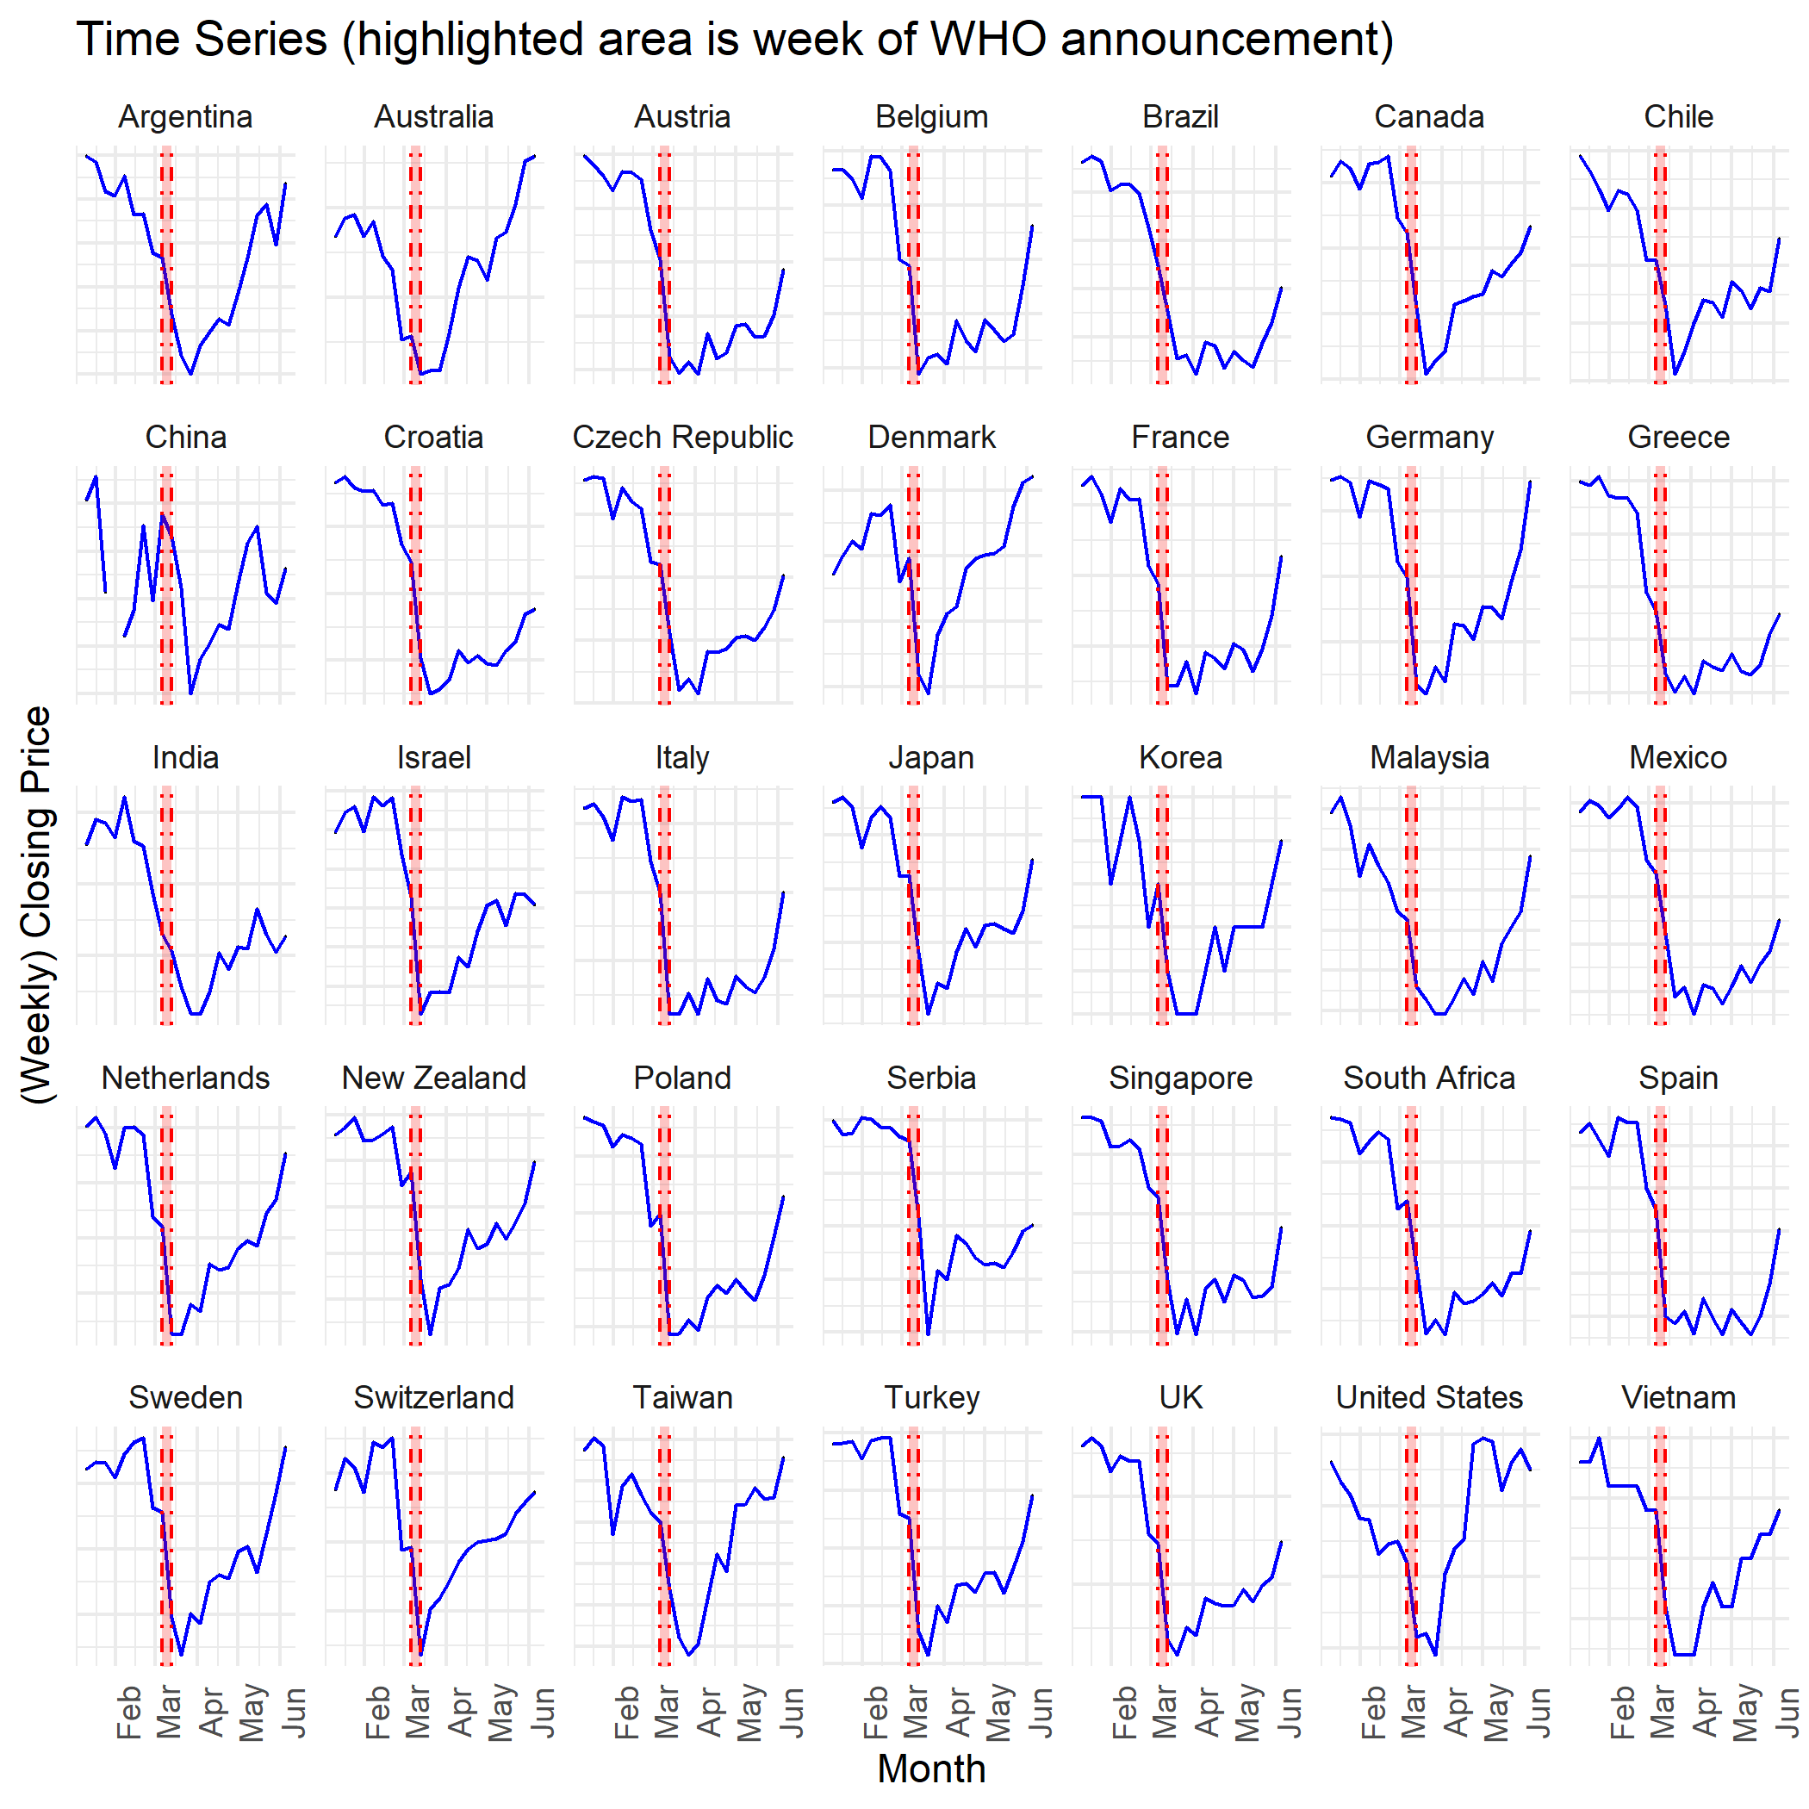
Domestic Stock Indices: Absolute Changes

Slide 5
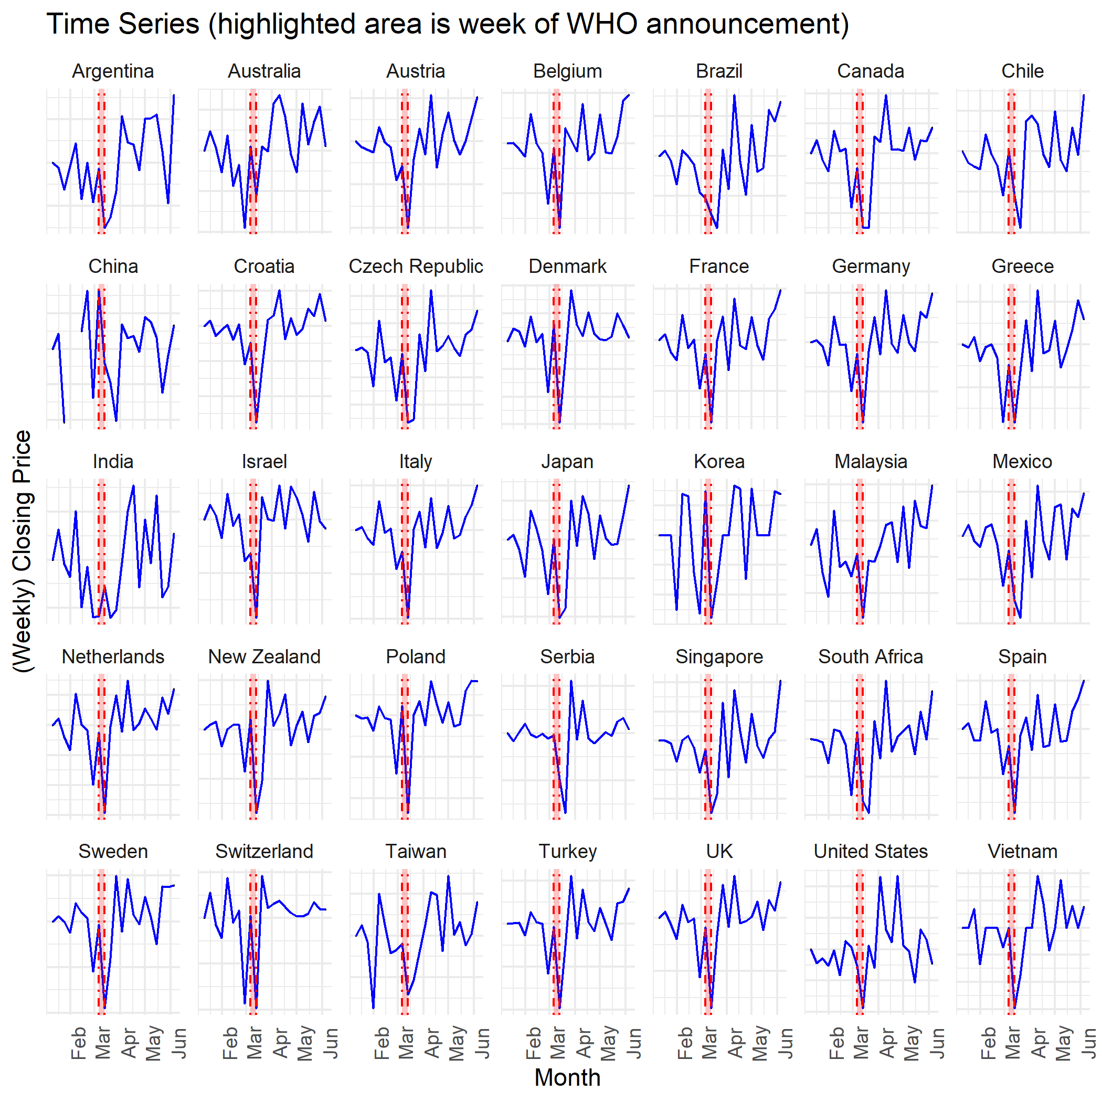
Domestic Stock Indices: Relative Changes

Slide 6
Hospital Beds Per 1000

Slide 7
Health Expenditure (as a % of GDP)

Slide 8
Analysis 1: Hospital Beds and Stock Performance

Slide 9
Results: Hospital Beds and Stock Performance

Slide 10
Analysis 2: Health Expenditure and Stock Performance

Slide 11
Results: Health Expenditure and Stock Performance

Slide 12
Hospital Beds and Stock Index Performance 2

Slide 13
Results

Slide 14
Health Expenditure and Stock Performance 2

Slide 15
Results

